Slide 1
Genetic Algorithm
Prepared By
Dr. T. Adilakshmi
Professor, Dept of CSE

Slide 2
Motivation
Genetic algorithms (GAS) provide a learning method motivated by an analogy to biological evolution. Rather than search from general-to-specific hypotheses
GAS generate successor hypotheses by repeatedly mutating and recombining parts of the best currently known hypotheses.
At each step, a collection of hypotheses called the current population is updated by replacing some fraction of the population by offspring of the most fit current hypotheses

Slide 3
GENETIC ALGORITHMS
The problem addressed by GAS is to search a space of candidate hypotheses to identify the best hypothesis.
In GAS the "best hypothesis" is defined as the one that optimizes a predefined numerical measure for the problem at hand, called the hypothesis fitness.
For example, if the learning task is the problem of approximating an unknown function given training examples of its input and output, then fitness could be defined as the accuracy of the hypothesis over this training data.
If the task is to learn a strategy for playing chess, fitness could be defined as the number of games won by the individual when playing against other individuals in the current population.

Slide 4
Structure of GA
The algorithm operates by iteratively updating a pool of hypotheses, called the population.
On each iteration, all members of the population are evaluated according to the fitness function.
A new population is then generated by probabilistically selecting the most fit individuals from the current population.
Some of these selected individuals are carried forward into the next generation population.
Others are used as the basis for creating new offspring individuals by applying genetic operations such as crossover and mutation.

Slide 5
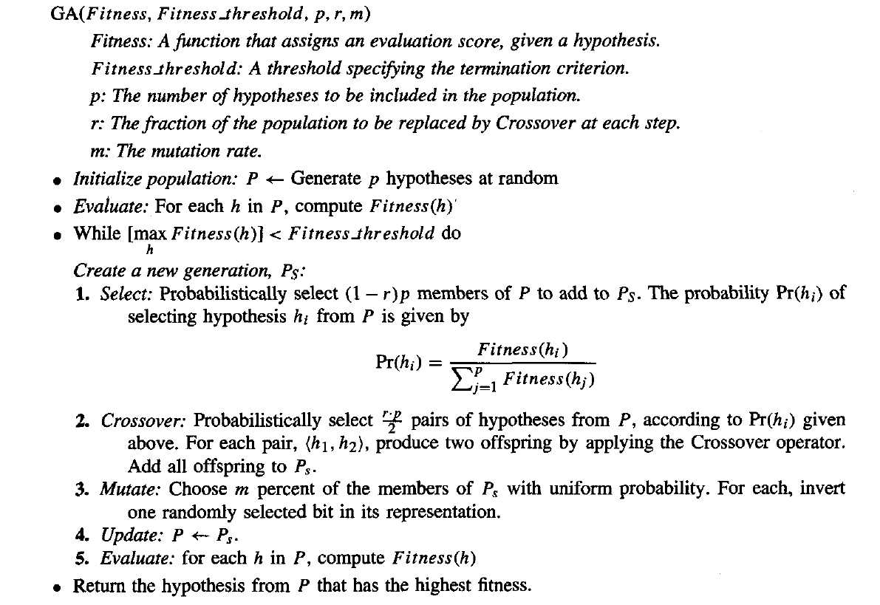
A prototypical genetic algorithm

Slide 6
A prototypical genetic algorithm
A population containing p hypotheses is maintained. On each iteration, the successor population Ps is formed by probabilistically selecting current hypotheses according to their fitness and by adding new hypotheses.
New hypotheses are created by applying a crossover operator to pairs of most fit hypotheses and by creating single point mutations in the resulting generation of hypotheses.
This process is iterated until sufficiently fit hypotheses are discovered. Typical crossover and mutation operators are defined in a subsequent table.

Slide 7
The inputs to this algorithm include the fitness function for ranking candidate hypotheses,
a threshold defining an acceptable level of fitness for terminating the algorithm,
the size of the population to be maintained,
and parameters that determine how successor populations are to be generated: the fraction of the population to be replaced at each generation and the mutation rate.

Slide 8
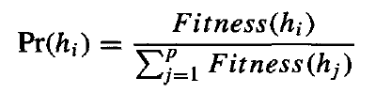
In this algorithm each iteration through the main loop produces a new generation of hypotheses based on the current population. First, a certain number of hypotheses from the current population are selected for inclusion in the next generation. These are selected probabilistically, where the probability of selecting hypothesis hi is given by
Thus, the probability that a hypothesis will be selected is proportional to its own fitness and is inversely proportional to the fitness of the other competing hypotheses in the current population.

Slide 9
Once these members of the current generation have been selected for inclusion in the next generation population, additional members are generated using a crossover operation.
It takes two parent hypotheses from the current generation and creates two offspring hypotheses by recombining portions of both parents.
The parent hypotheses are chosen probabilistically from the current population, again using the probability function
After new members have been created by this crossover operation, the new generation population now contains the desired number of members.
At this point, a certain fraction m of these members are chosen at random, and random mutations all performed to alter these members

Slide 10
Representing Hypotheses
Hypotheses in GAS are often represented by bit strings, so that they can be easily manipulated by genetic operators such as mutation and crossover. The hypotheses represented by these bit strings can be quite complex. For example, sets of if-then rules can easily be represented in this way, by choosing an encoding of rules that allocates specific substrings for each rule precondition and post condition.

Slide 11
Use a bit string to describe a constraint on the value of a single attribute.
Consider the attribute Outlook, which can take on any of the three values Sunny, Overcast, or Rain. One obvious way to represent a constraint on Outlook is to use a bit string of length three, in which each bit position corresponds to one of its three possible values.
Placing a 1 in some position indicates that the attribute is allowed to take on the corresponding value. For example, the string 010 represents the constraint that Outlook must take on the second of these values, , or Outlook = Overcast. Similarly, the string 011 represents the more general constraint that allows two possible values, or (Outlook = Overcast v Rain).
11 1 represents the most general possible constraint, indicating that we don't care which of its possible values the attribute takes on.

Slide 12
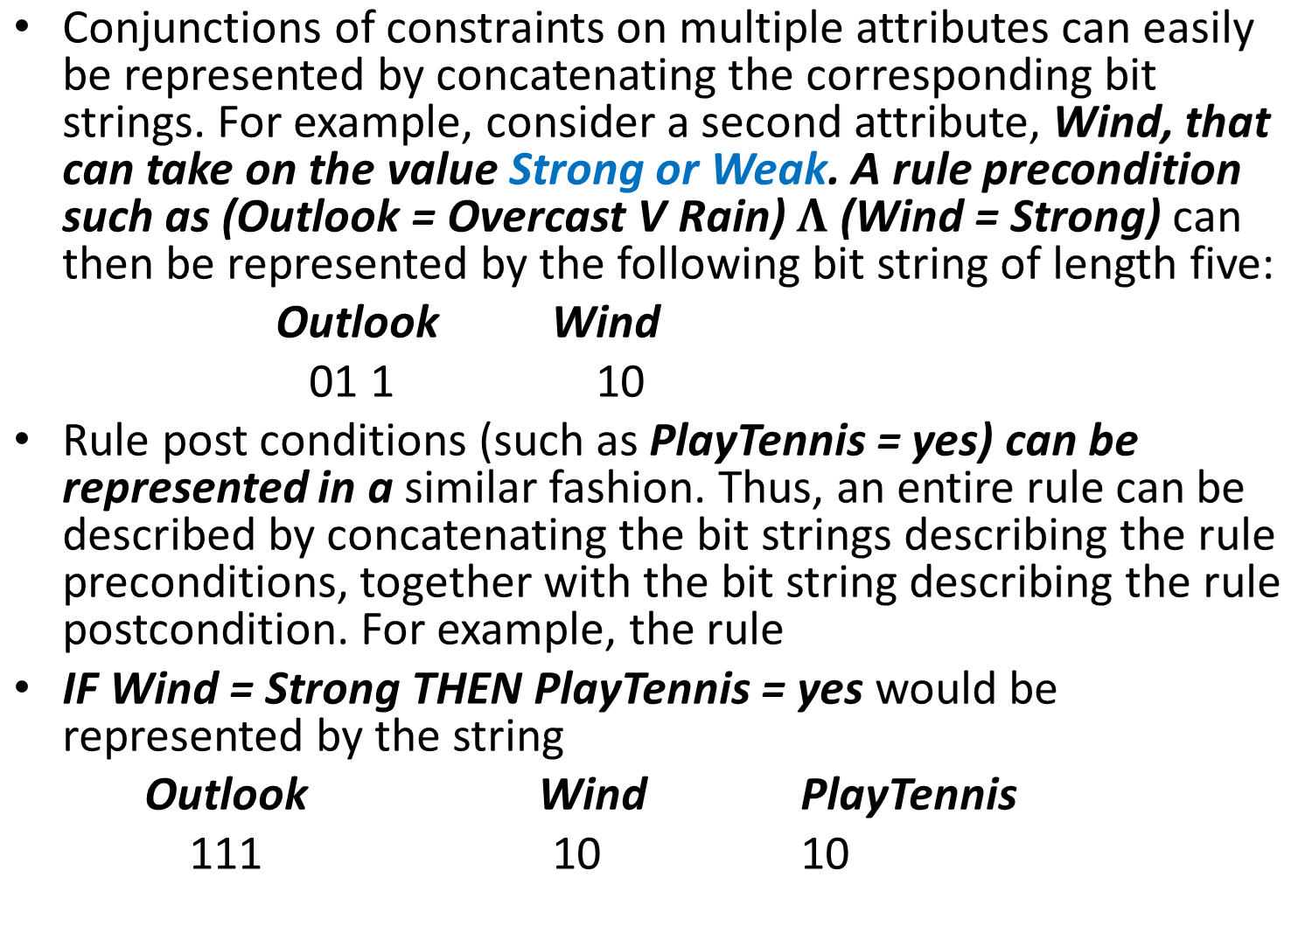

Slide 13
where the first three bits describe the "don't care" constraint on Outlook, the next two bits describe the constraint on Wind, and the final two bits describe the rule post condition (here we assume PlayTennis can take on the values Yes or No).
Note the bit string representing the rule contains a substring for each attribute in the hypothesis space, even if that attribute is not constrained by the rule preconditions.
This yields a fixed length bit-string representation for rules, in which substrings at specific locations describe constraints on specific attributes. Given this representation for single rules, we can represent sets of rules by similarly concatenating the bit string representations of the individual rules.
In some GAS, hypotheses are represented by symbolic descriptions rather than bit strings.

Slide 14
Genetic Operators
The generation of successors in a GA is determined by a set of operators that recombine and mutate selected members of the current population.
These operators correspond to idealized versions of the genetic operations found in biological evolution. The two most common operators are crossover and mutation
The crossover operator produces two new offspring from two parent strings, by copying selected bits from each parent. The bit at position i in each offspring is copied from the bit at position i in one of the two parents. The choice of which parent contributes the bit for position i is determined by an additional string called the crossover mask consider the single-point crossover operator
This offspring takes its first five bits from the first parent and its remaining six bits from the second parent, because the crossover mask 11 11 1000000 specifies these choices for each of the bit positions. The second offspring uses the same crossover mask, but switches the roles of the two parents. Therefore, it contains the bits that were not used by the first offspring

Slide 15
Crossover
In single-point crossover, the crossover mask is always constructed so that it begins with a string containing n contiguous Is, followed by the necessary number of 0s to complete the string. This results in offspring in which the first n bits are contributed by one parent and the remaining bits by the second parent. Each time the single-point crossover operator is applied, the crossover point n is chosen at random, and the crossover mask is then created and applied
In two-point crossover, offspring are created by substituting intermediate segments of one parent into the middle of the second parent string. Put another way, the crossover mask is a string beginning with no zeros, followed by a contiguous string of nl ones, followed by the necessary number of zeros to complete the string.
Each time the two-point crossover operator is applied, a mask is generated by randomly choosing the integers no and nl. For instance, in the example shown the offspring are created using a mask for which no = 2 and n 1 = 5. Again, the two offspring are created by switching the roles played by the two parents.

Slide 16
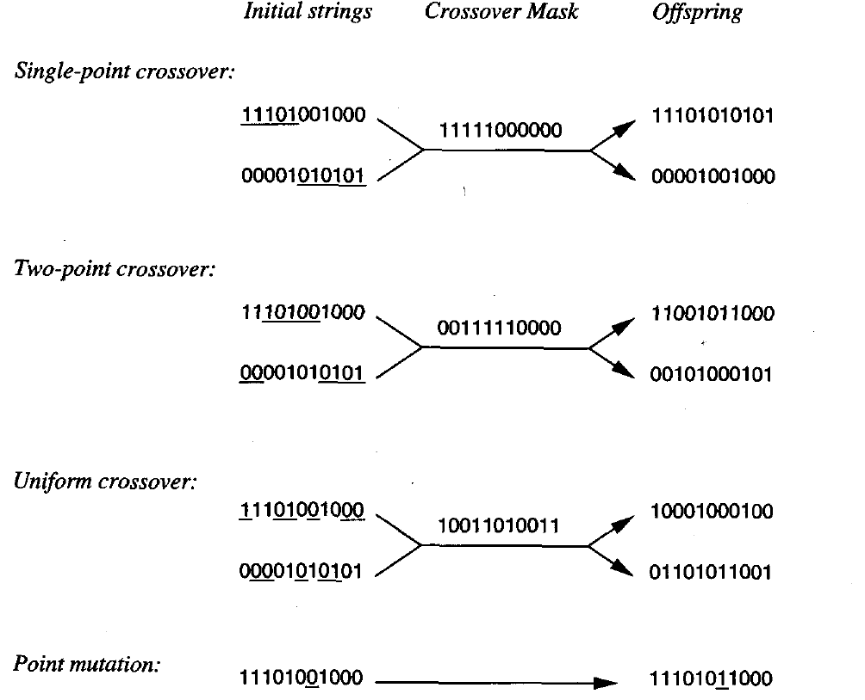
Common operators for genetic algorithms

Slide 17
Uniform crossover combines bits sampled uniformly from the two parents, In this case the crossover mask is generated as a random bit string with each bit chosen at random and independent of the others.
In addition to recombination operators that produce offspring by combining parts of two parents, a second type of operator produces offspring from a single parent.
In particular, the mutation operator produces small random changes to the bit string by choosing a single bit at random, then changing its value.
Mutation is often performed after crossover has been applied as in our prototypical algorithm

Slide 18
Fitness Function and Selection
The fitness function defines the criterion for ranking potential hypotheses and for probabilistically selecting them for inclusion in the next generation population.
If the task is to learn classification rules, then the fitness function typically has a component that scores the classification accuracy of the rule over a set of provided training examples. Often other criteria may be included as well, such as the complexity or generality of the rule.
More generally, when the bit-string hypothesis is interpreted as a complex procedure (e.g., when the bit string represents a collection of if-then rules that will be chained together to control a robotic device), the fitness function may measure the overall performance of the resulting procedure rather than performance of individual rules.
The probability that a hypothesis will be selected is given by the ratio of its fitness to the fitness of other members of the current population
This method is sometimes called fitness proportionate selection, or roulette wheel selection.

Slide 19
Other methods for using fitness to select hypotheses have also been proposed. tournament selection, two hypotheses are first chosen at random from the current population. With some predefined probability p the more fit of these two is then selected, and with probability (1 - p) the less fit hypothesis is selected. Tournament selection often yields a more diverse population than fitness proportionate selection
In another method called rank selection, the hypotheses in the current population are first sorted by fitness. The probability that a hypothesis will be selected is then proportional to its rank in this sorted list, rather than its fitness.

Slide 20
GA EXAMPLE
A genetic algorithm can be viewed as a general optimization method that searches a large space of candidate objects seeking one that performs best according to the fitness function.
GAS often succeed in finding an object with high fitness. GAS have been applied to a number of optimization problems outside machine learning, including problems such as circuit layout and job-shop scheduling. Within machine learning, they have been applied both to function-approximation problems and to tasks such as choosing the network topology for artificial neural network learning systems
GABIL uses a GA to learn boolean concepts represented by a disjunctive set of propositional rules. the parameter r, which determines the fraction of the parent population replaced by crossover, was set to 0.6. The parameter m, which determines the mutation rate, was set to 0.001.
These are typical settings for these parameters. The population size p was varied from 100 to 1000, depending on the specific learning task.

Slide 21


The specific instantiation of the GA algorithm in GABIL
Representation: Each hypothesis in GABIL corresponds to a disjunctive set of propositional rules
The hypothesis space of rule preconditions consists of a conjunction of constraints on a fixed set of attributes
To represent a set of rules, the bit-string representations of individual rules are concatenated.
Consider a hypothesis space in which rule preconditions are conjunctions of constraints over two boolean attributes, a1 and a2.
The rule postcondition is described by a single bit that indicates the predicted value of the target attribute c. Thus, the hypothesis consisting of the two rules
IF al = T a2 = F THEN c = T; IF a2 = T THEN c = F would be represented by the string
The length of the bit string grows with the number of rules in the hypothesis.

Slide 22
Genetic operators
GABIL uses the standard mutation operator in which a single bit is chosen at random and replaced by its complement.
The crossover operator that it uses is a fairly standard extension to the two-point crossover operator described in Table 9.2. In particular, to accommodate the variable-length bit strings that encode rule sets, and to constrain the system so that crossover occurs only between like sections of the bit strings that encode rules, the following approach is taken.
To perform a crossover operation on two parents, two crossover points are first chosen at random in the first parent string. Let dl (d2) denote the distance from the leftmost (rightmost) of these two crossover points to the rule boundary immediately to its left.
The crossover points in the second parent are now randomly chosen, subject to the constraint that they must have the same dl and d2 value
if the two parent strings are

Slide 23
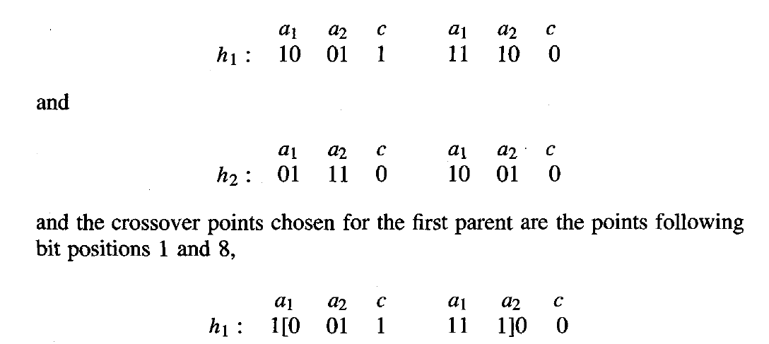
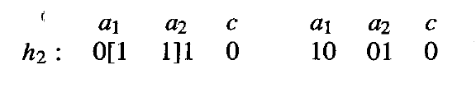
where "[" and “]" indicate crossover points, then dl = 1 and d2 = 3. Hence the allowed pairs of crossover points for the second parent include the pairs of bit positions (1,3), (1,8), and (6,8). If the pair (1,3) happens to be chosen,

Slide 24
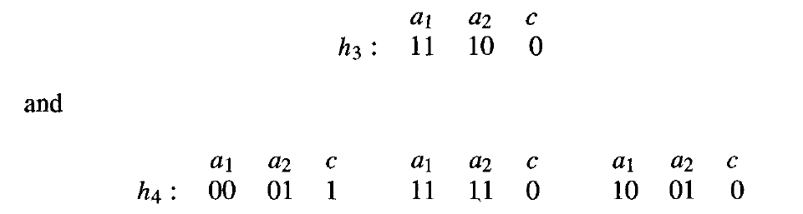
then the two resulting offspring will be
this crossover operation enables offspring to contain a different number of rules than their parents, while assuring that all bit strings generated in this fashion represent well-defined rule sets.

Slide 25

Fitness function
The fitness of each hypothesized rule set is based on its classification accuracy over the training data. In particular, the function used to measure fitness is where correct (h) is the percent of all training examples correctly classified by hypothesis h.

Slide 26
GENETIC PROGRAMMING
Genetic programming (GP) is a form of evolutionary computation in which the individuals in the evolving population are computer programs rather than bit strings
Representing Programs : Programs manipulated by a GP are typically represented by trees corresponding to the parse tree of the program. Each function call is represented by a node in the tree, and the arguments to the function are given by its descendant nodes.

Slide 27

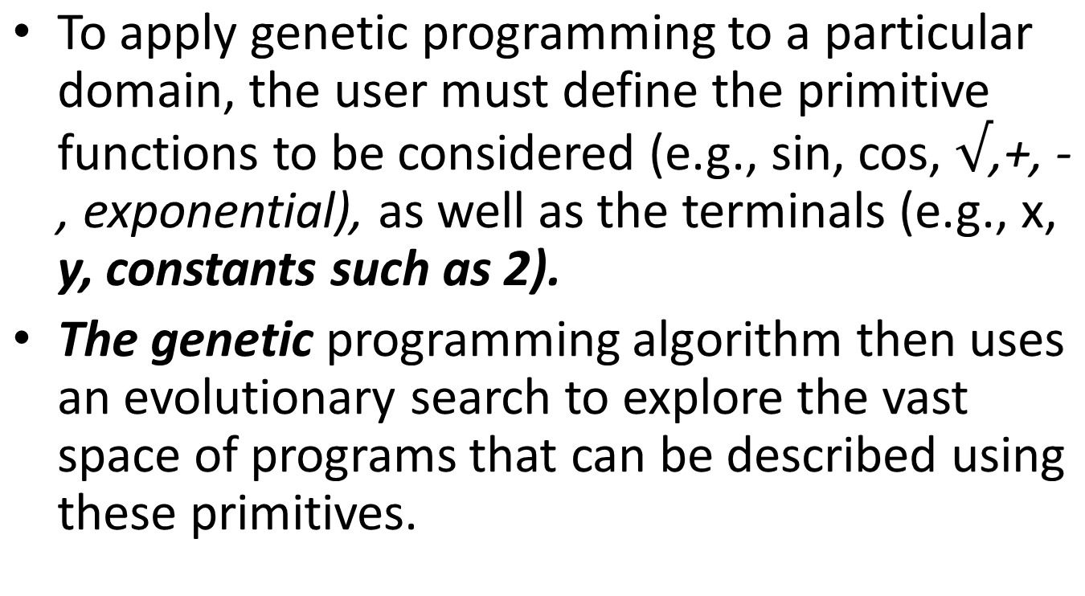
For example, Figure 9.1 illustrates this tree representation for the function

Slide 28
As in a genetic algorithm, the prototypical genetic programming algorithm maintains a population of individuals (in this case, program trees). On each iteration, it produces a new generation of individuals using selection, crossover, and mutation.
The fitness of a given individual program in the population is typically determined by executing the program on a set of training data.
Crossover operations are performed by replacing a randomly chosen sub tree of one parent program by a sub tree from the other parent program

Slide 29
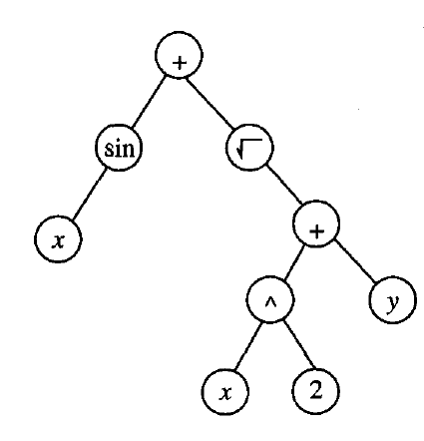
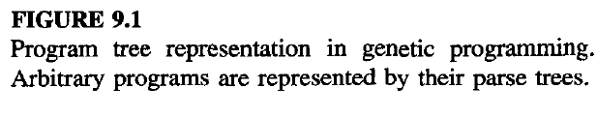

Slide 30
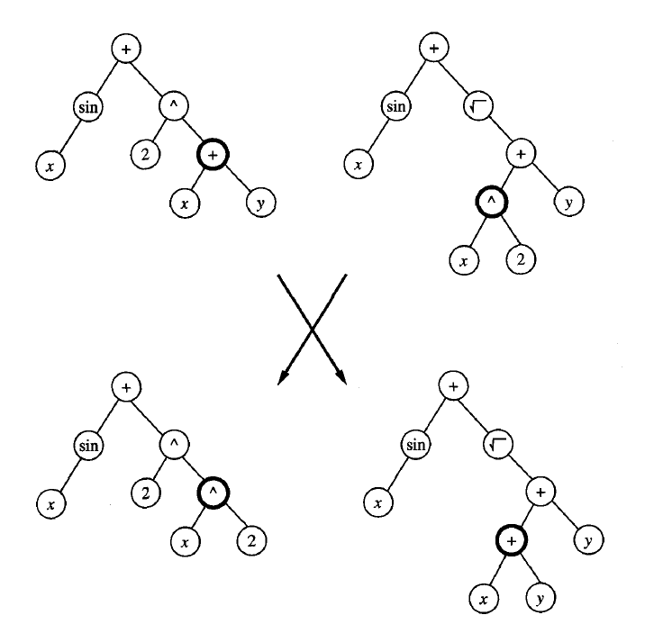
FIGURE 9.2
Crossover operation applied to two parent program trees (top). Crossover points (nodes shown in bold at top) are chosen at random. The subtrees rooted at these crossover points are then exchanged to create children trees (bottom).

Slide 31
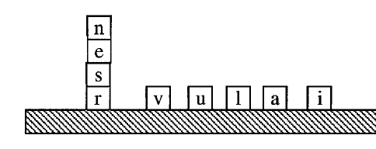
Example
One illustrative example presented by Koza (1992) involves learning an algorithm for stacking the blocks shown in figure 9.3. The task is to develop a general algorithm for stacking the blocks into a single stack that spells the word "universal,“ independent of the initial configuration of blocks in the world.
The actions available for manipulating blocks allow moving only a single block at a time. In particular, the top block on the stack can be moved to the table surface, or a block on the table surface can be moved to the top of the stack.

Slide 32
stacking the blocks
The primitive functions used to compose programs for this task include the following three terminal arguments:
CS (current stack), which refers to the name of the top block on the stack, or F if there is no current stack.
TB (top correct block), which refers to the name of the topmost block on the stack, such that it and those blocks beneath it are in the correct order.
NN (next necessary), which refers to the name of the next block needed above TB in the stack, in order to spell the word "universal," or F if no more blocks are needed.
This particular choice of terminal arguments provides a natural representation for describing programs for manipulating blocks for this task.

Slide 33
primitive functions:
In addition to these terminal arguments, the program language in this application included the following primitive functions:
(MS x) (move to stack), if block x is on the table, this operator moves x to the top of the stack and returns the value T. Otherwise, it does nothing and returns the value F.
(MT x) (move to table), if block x is somewhere in the stack, this moves the block at the top of the stack to the table and returns the value T. Otherwise, it returns the value F.
(EQ x y) (equal), which returns T if x equals y, and returns F otherwise.
(NOT x), which returns T if x = F, and returns F if x = T.
(DU x y) (do until), which executes the expression x repeatedly until expression y returns the value T.

Slide 34
primitive functions:
To allow the system to evaluate the fitness of any given program, Koza provided a set of 166 training example problems representing a broad variety of initial block configurations, including problems of differing degrees of difficulty.
The fitness of any given program was taken to be the number of these examples solved by the algorithm. The population was initialized to a set of 300 random programs. After 10 generations, the system discovered the following program, which solves all 166 problems.
(EQ (DU (MT CS)(NOT CS)) (DU (MS NN)(NOT NN)) )

Slide 35
program contains a sequence of two DU, or "Do Until" statements.
The first repeatedly moves the current top of the stack onto the table, until the stack becomes empty.
The second "Do Until" statement then repeatedly moves the next necessary block from the table onto the stack.
The role played by the top level EQ expression here is to provide a syntactically legal way to sequence these two "Do Until" loops.

